Slide 1

Machin Learning - Introduction - Types
한성대학교
컴퓨터공학과 김바다

Slide 2
CONTENTS.
Intoduction
Why
How
What
Types
Supervised
Unsupervised

Slide 3
1. INTRODUCTION

Slide 4

01. Introduction
WHY?
If can you want an answer 3 + 3,
can you get it? YES
INPUT
3
OUTPUT
6
3

Slide 5
01. Introduction
WHY?
If can you want an answer 3 x 3,
can you get it? NO
INPUT
3
OUTPUT
3

Slide 6
01. Introduction
WHY?
[1] If so?
Need to separate program / logic
INPUT
3
OUTPUT
6
3
INPUT
3
OUTPUT
9
3

Slide 7

01. Introduction
WHY?
[2] If so?
<Traditional Programming>

Slide 8
01. Introduction
WHY?
[2] If so?
<Machine Learning>

Slide 9
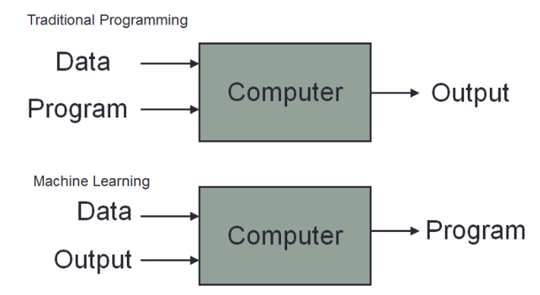
01. Introduction
HOW?

Slide 10
01. Introduction
HOW?
2 + 3
5
(Result)
2 + 3
5
(Prediction)

Slide 11



01. Introduction
WHAT?
Machine learning
1. Learning from data
2. building the logic
3. prediction the output

Slide 12
2. TYPE

Slide 13
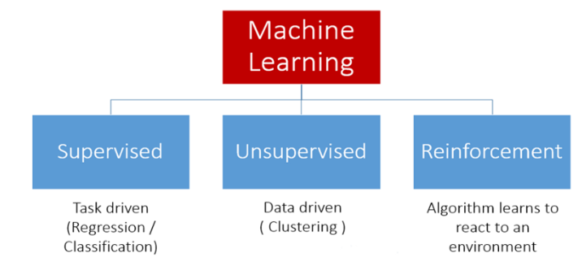
02. Type

Slide 14

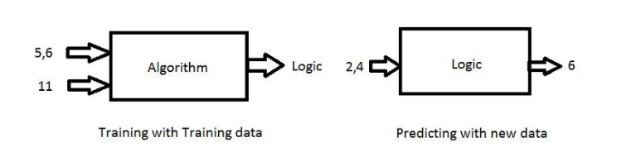
02. Type

Slide 15
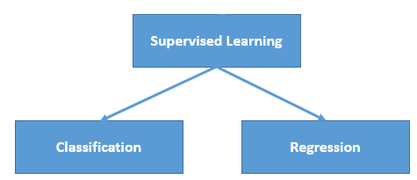
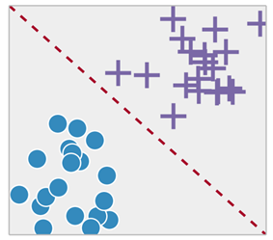
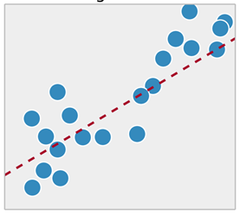
02. Type
Categorical
-response
Continuous
-response

Slide 16

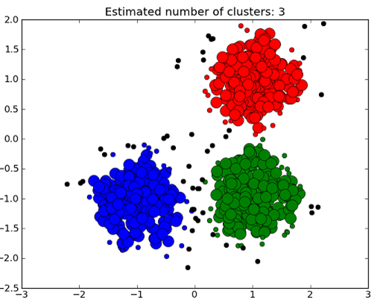
02. Type
Don’t provide the lables
Clustering
Bit difficult to implement and its not used as widely as supervised.
Notes:
다른 타입 뉴스찾기
유사 이미지 분류

Slide 17

02. Type
Algorithm Learns to react to an environment
Reward
Powerful and complex to apply for problems
Notes:
보상을 최대화 하는 방향으로 행동을 선택하는 방식

Slide 18
Q & A

